Slide 1
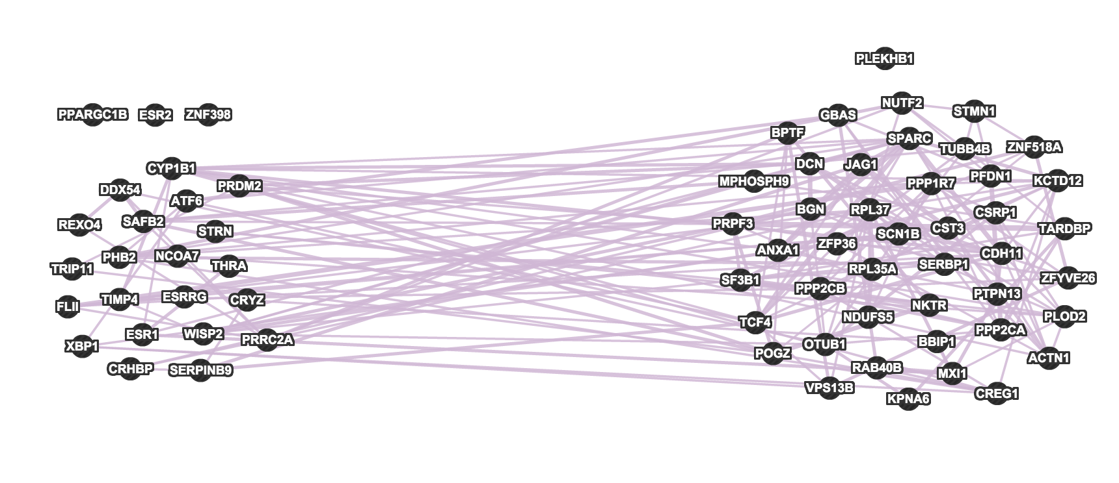
{ESR1, 24} (Static Module)

Slide 2
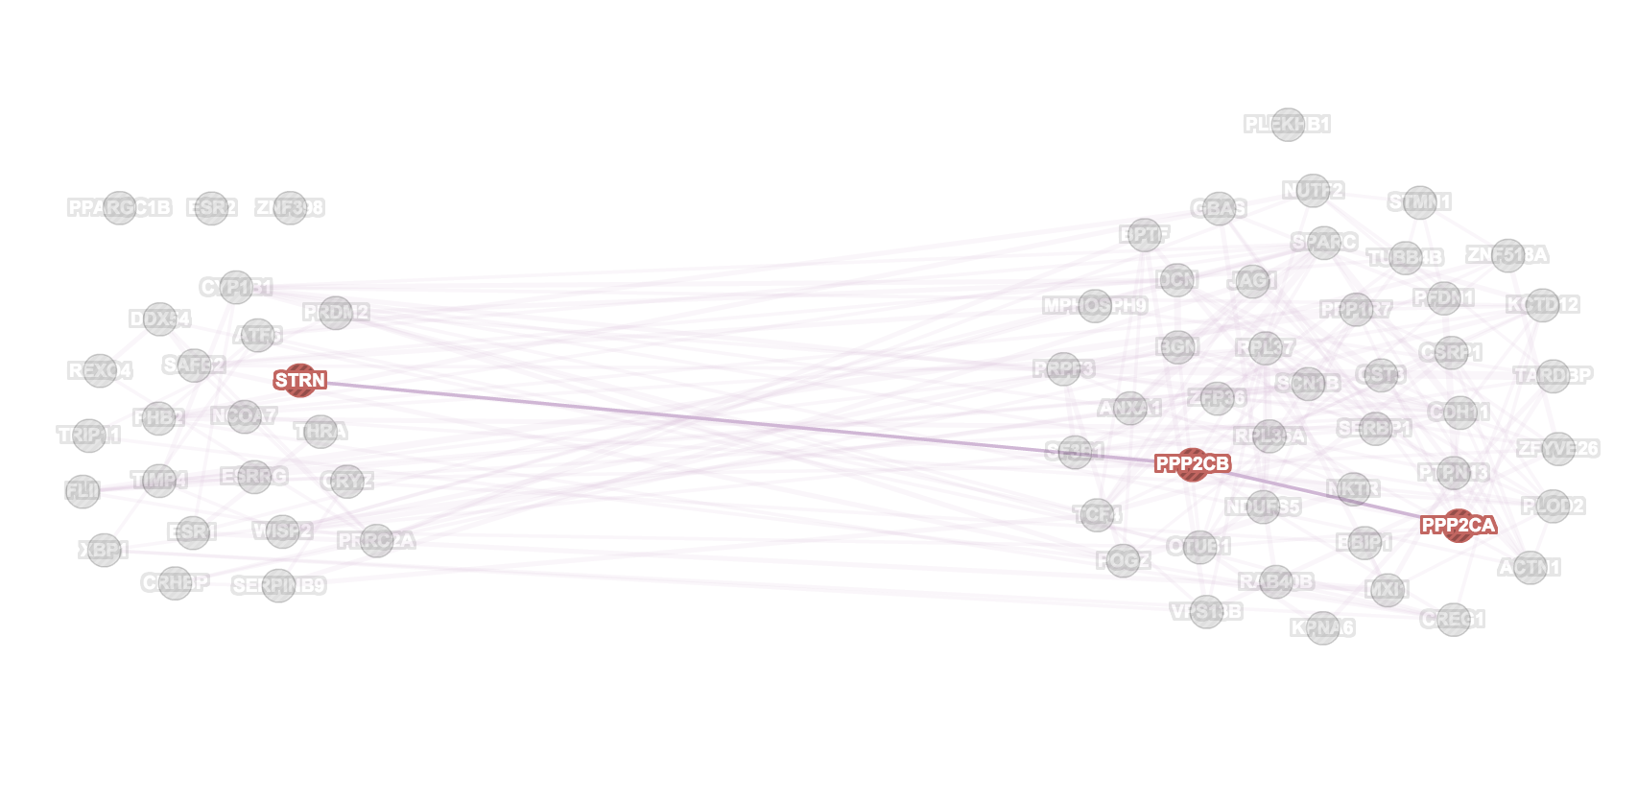
protein phosphatase type 2A complex

Slide 3
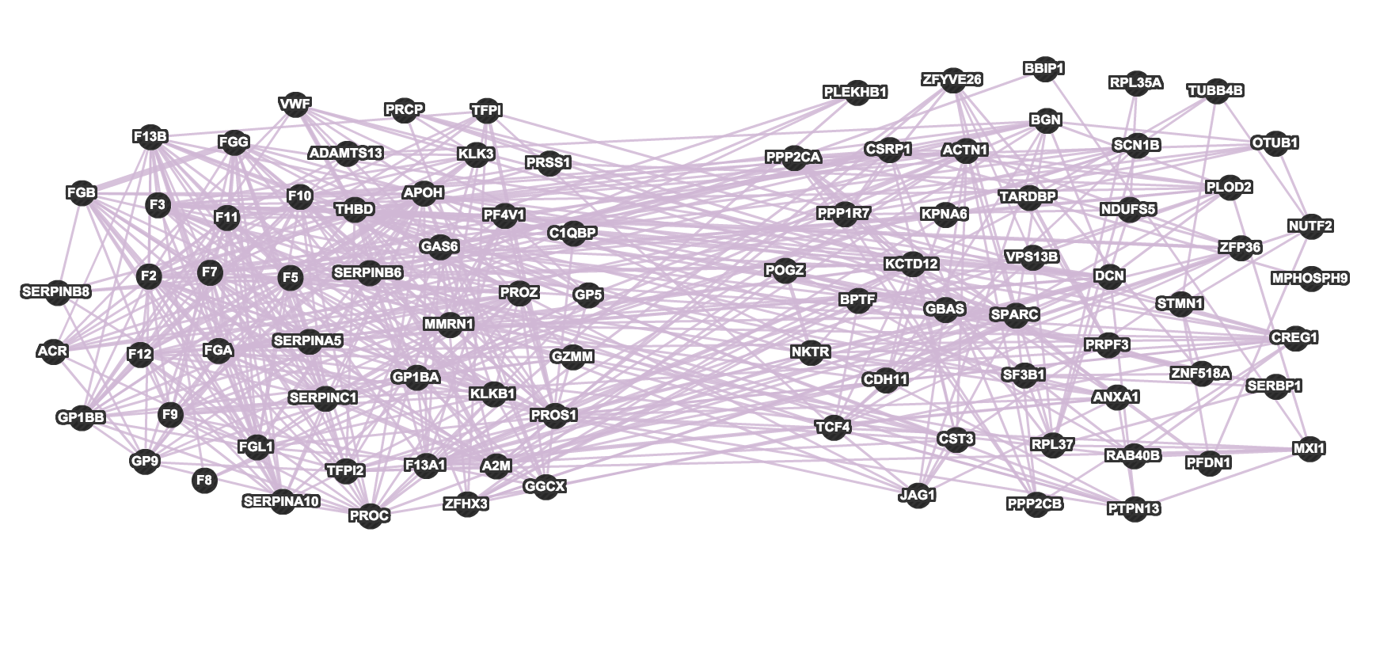
{F2, 46} (Static Module)

Slide 4
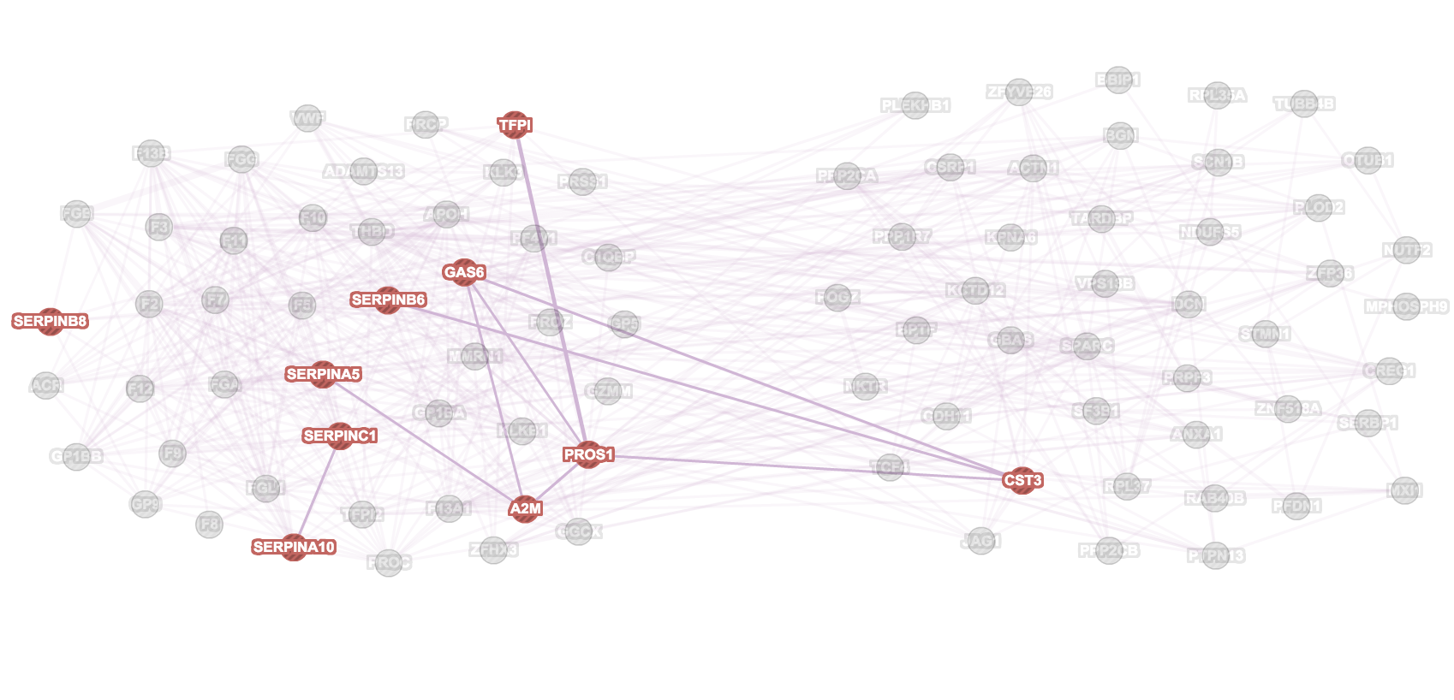
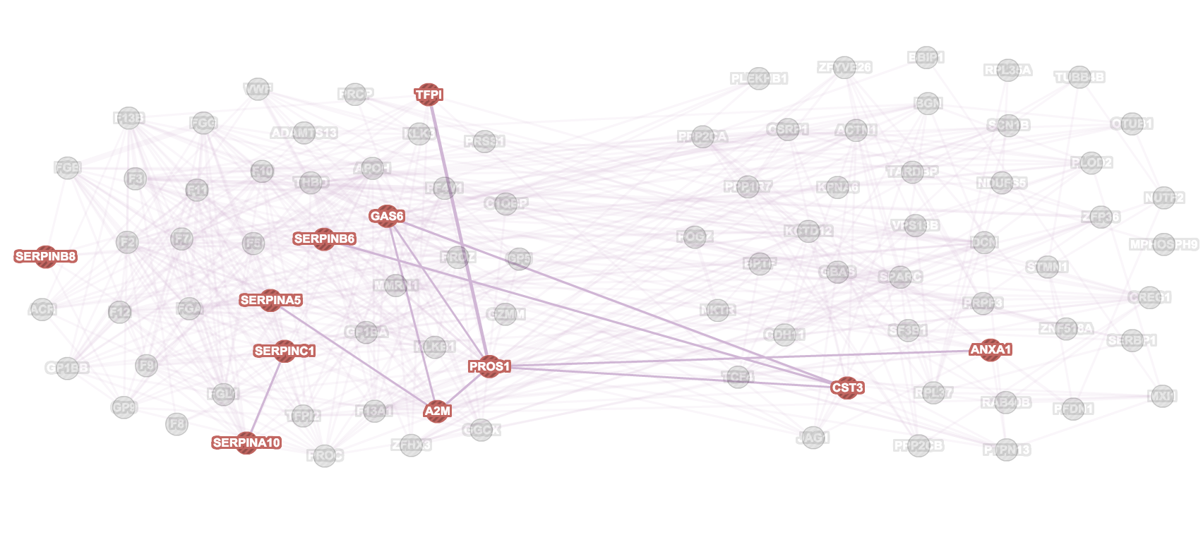
Endopeptidase/peptidase/hydrolase regulator activity
Enzyme inhibitor activity

Slide 5
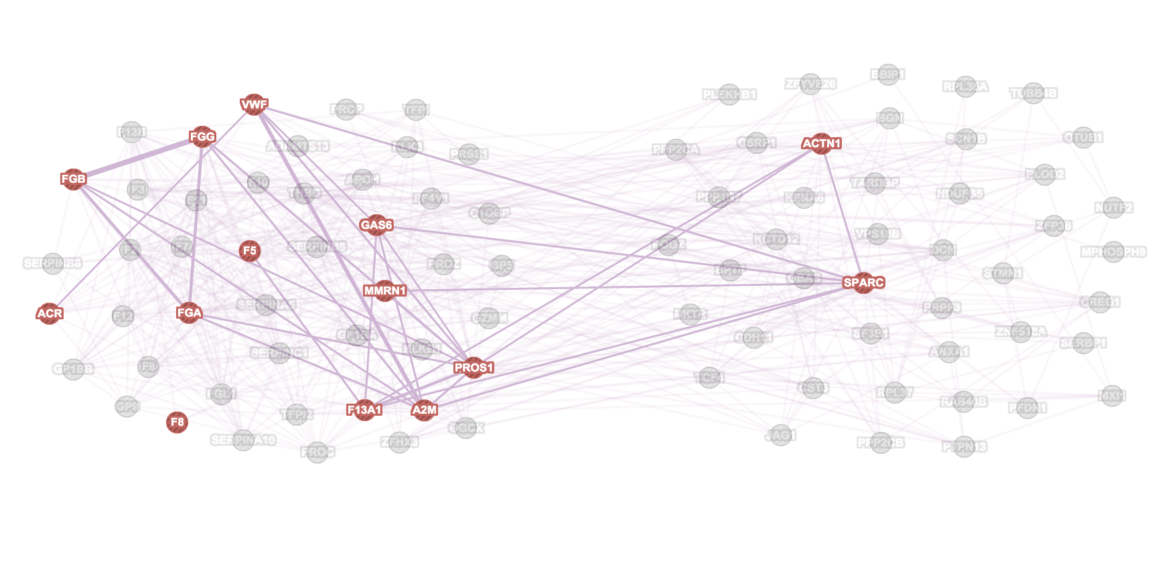
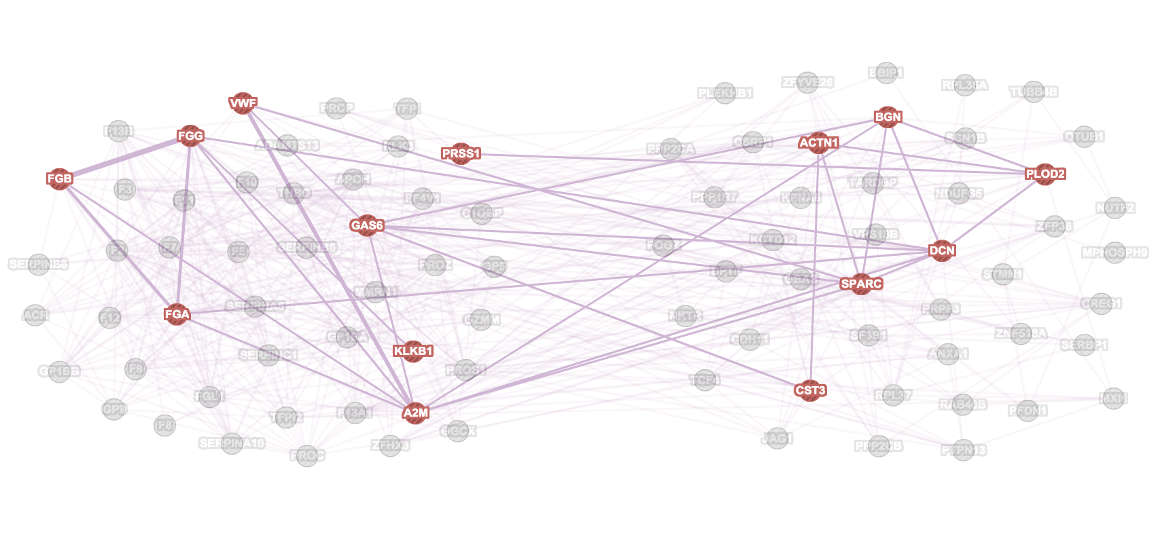
Exocytosis
Extracellular matrix organisation

Slide 6
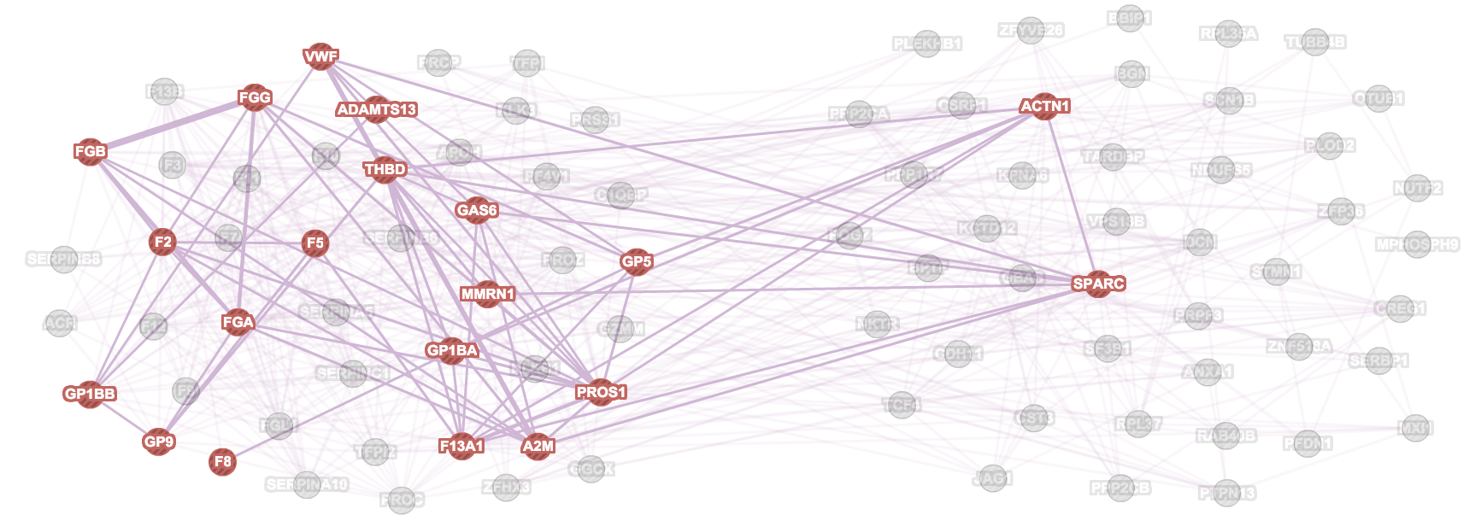
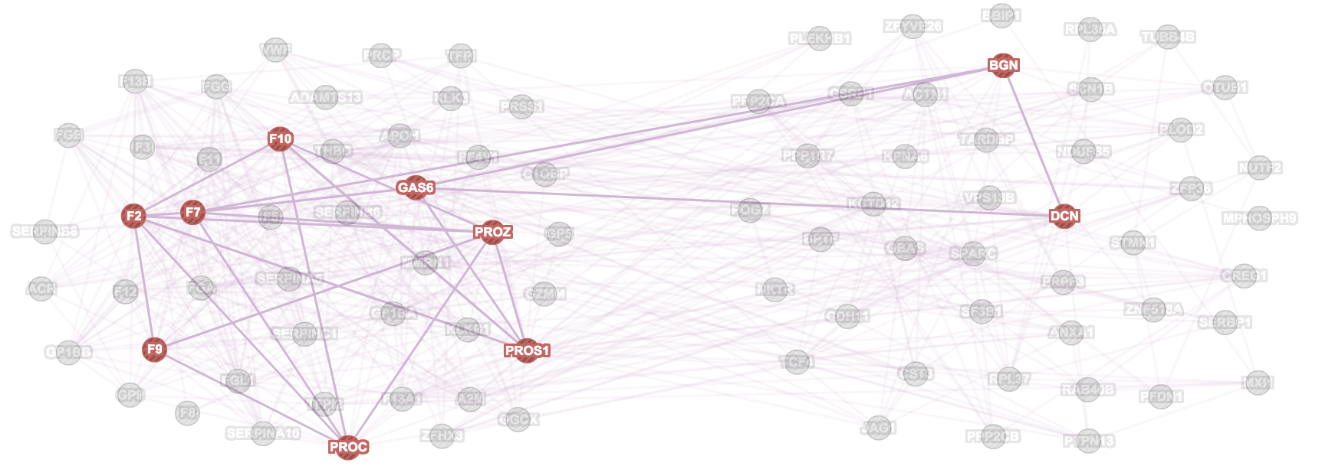
Platelet Activation
Golgi Lumen

Slide 7
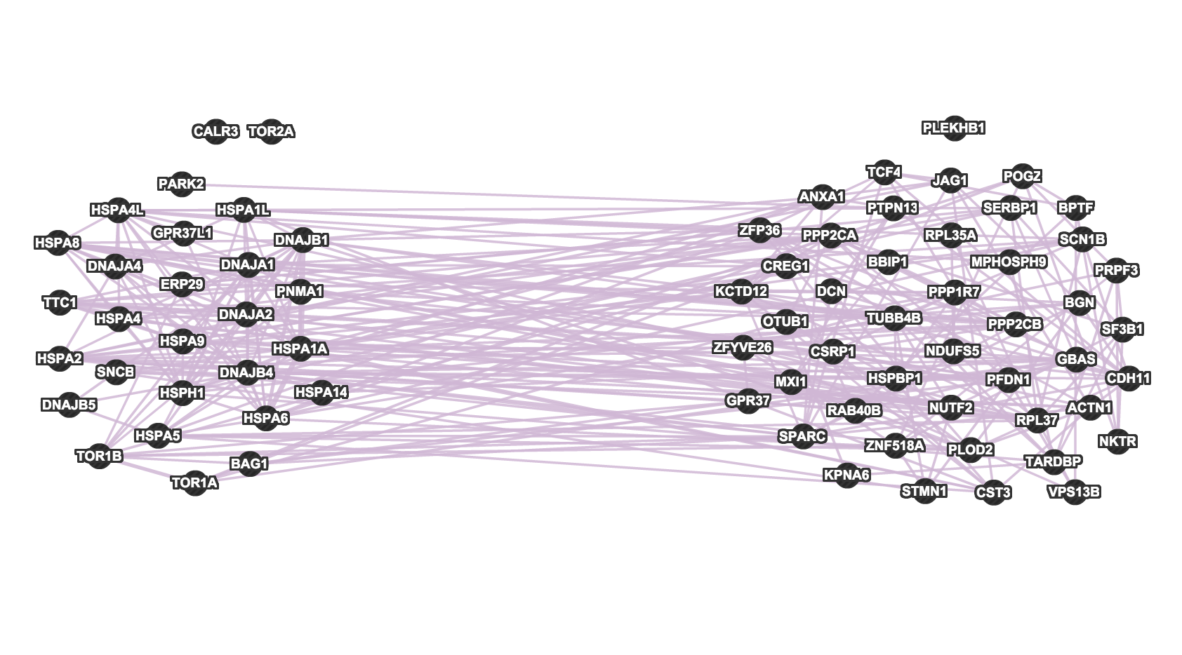
{HSPA8, 34} (Static Module)

Slide 8
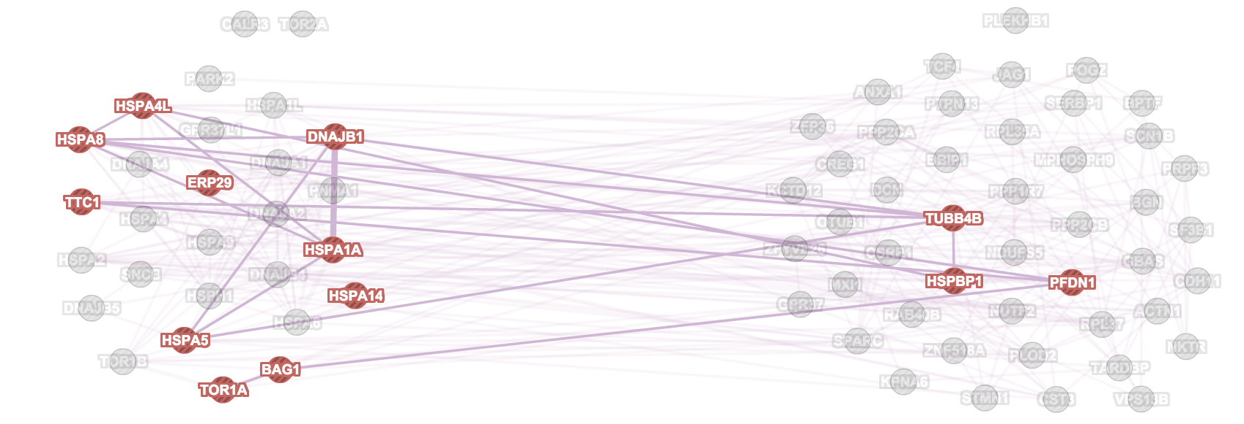
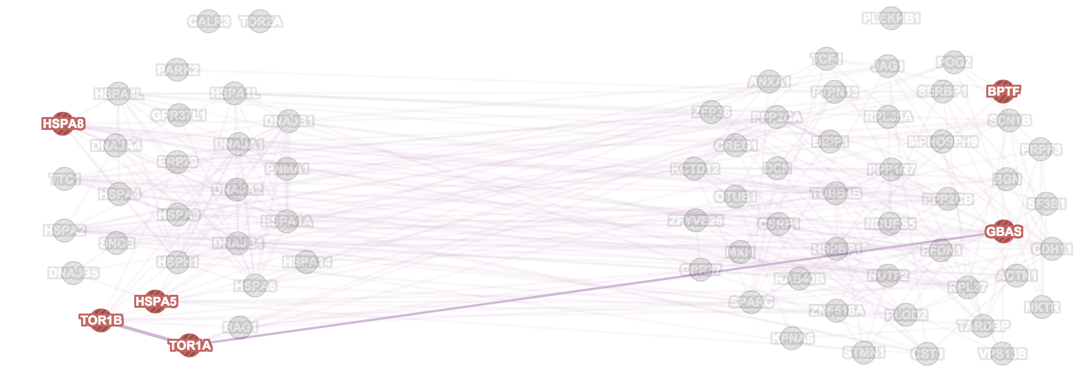
Protein Folding
ATP metabolic process

Slide 9
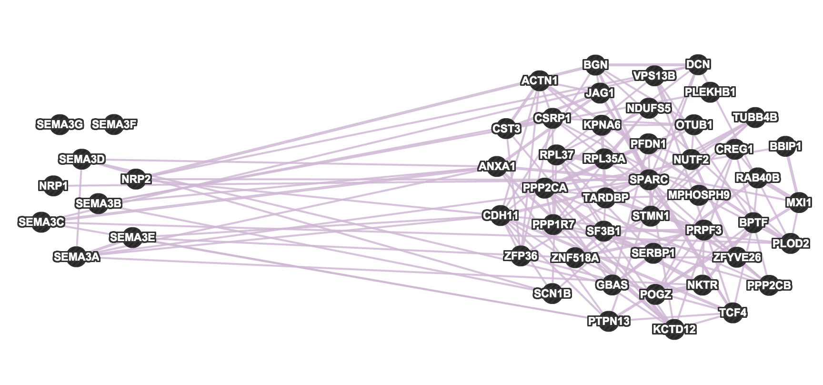
{NRP1,11} (Static Module)

Slide 10
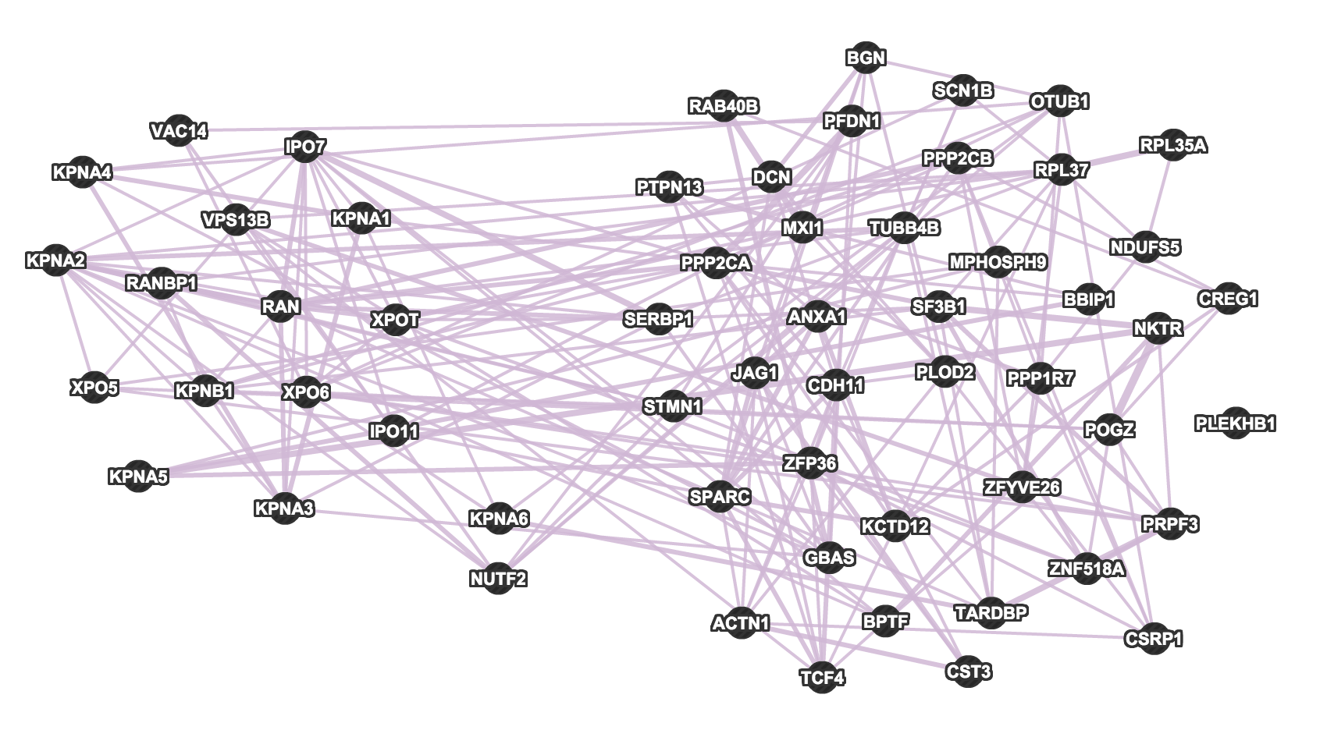
{RAN,17} (Static Module)

Slide 11
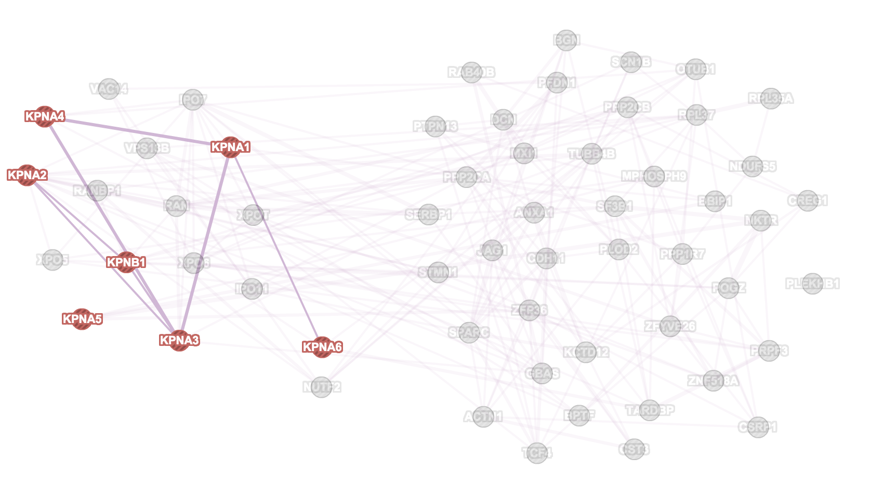
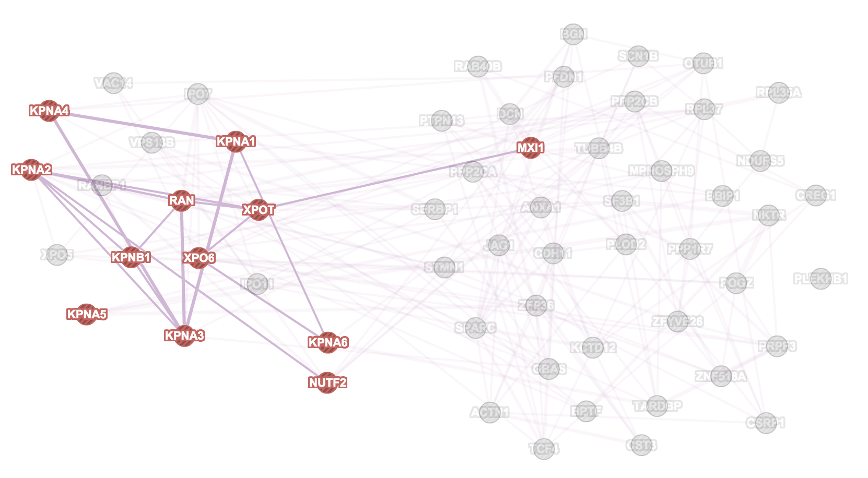
NLS-bearing protein import into nucleus
Nuclear Transport

Slide 12
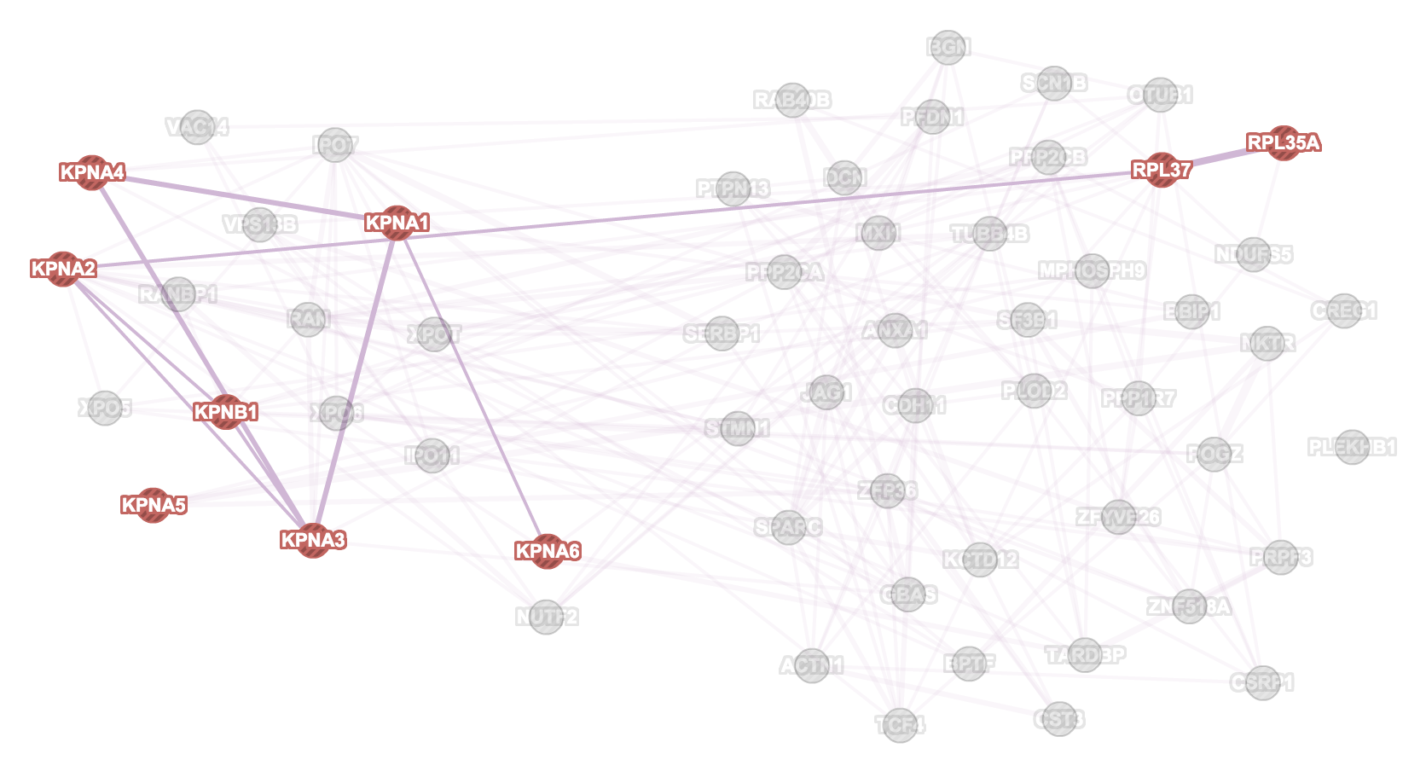
NLS-bearing protein import into nucleus
Protein Targeting

Slide 13
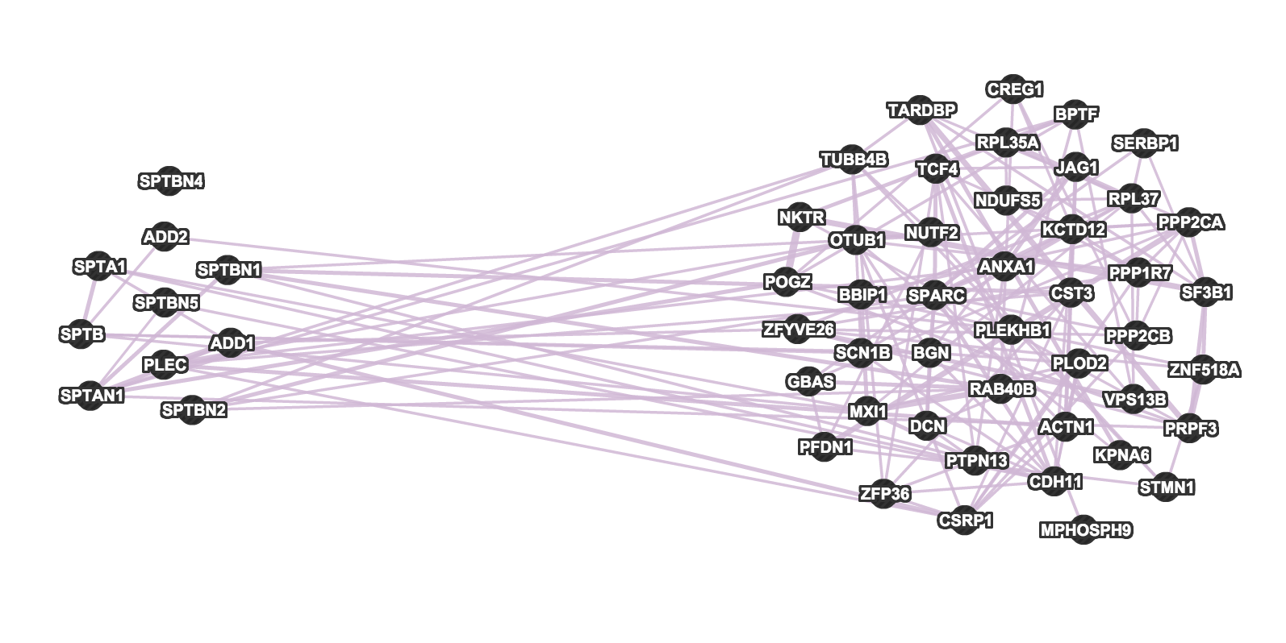
{SPTAN1,10} (Static Module)

Slide 14
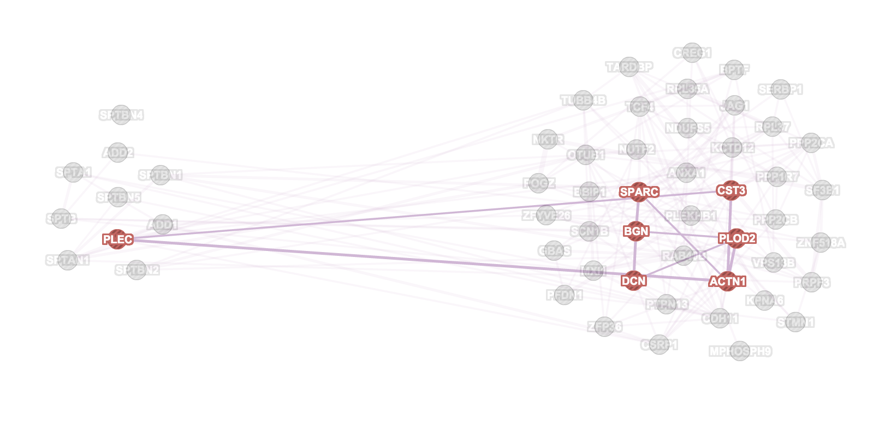
NLS-bearing protein import into nucleus
Extracellular Matrix Organisation

Slide 15
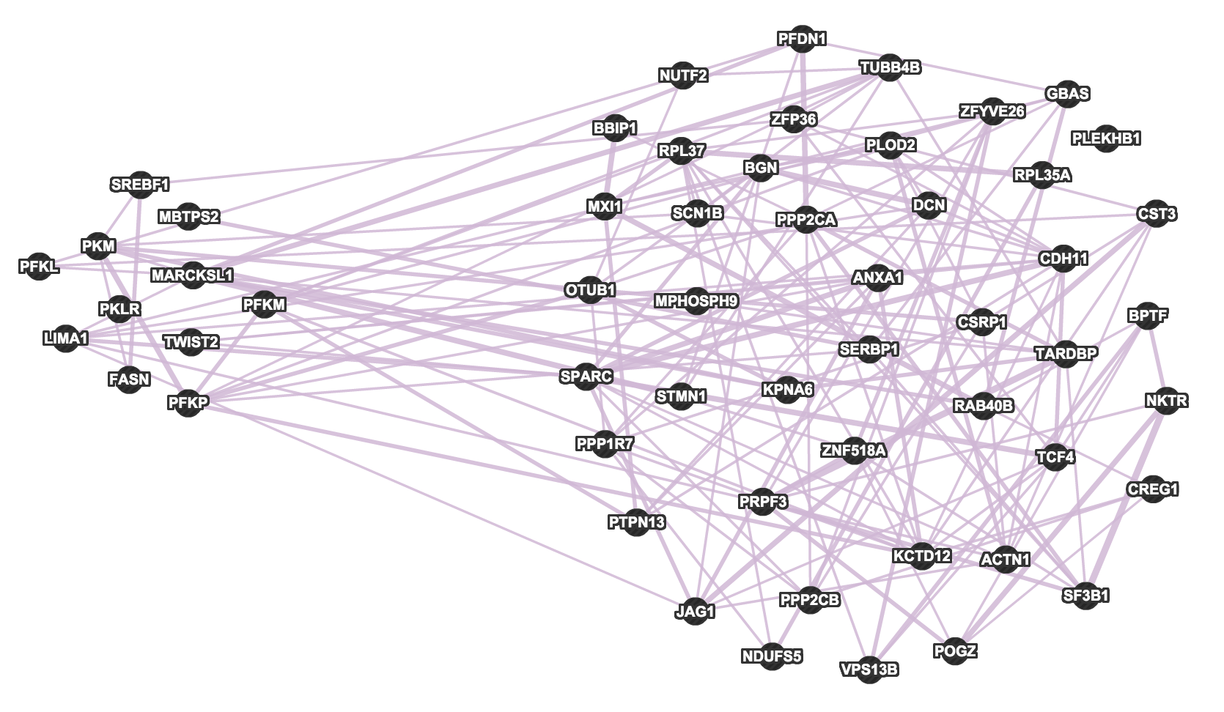
{SREBF1,11} (Static Module)

Slide 16
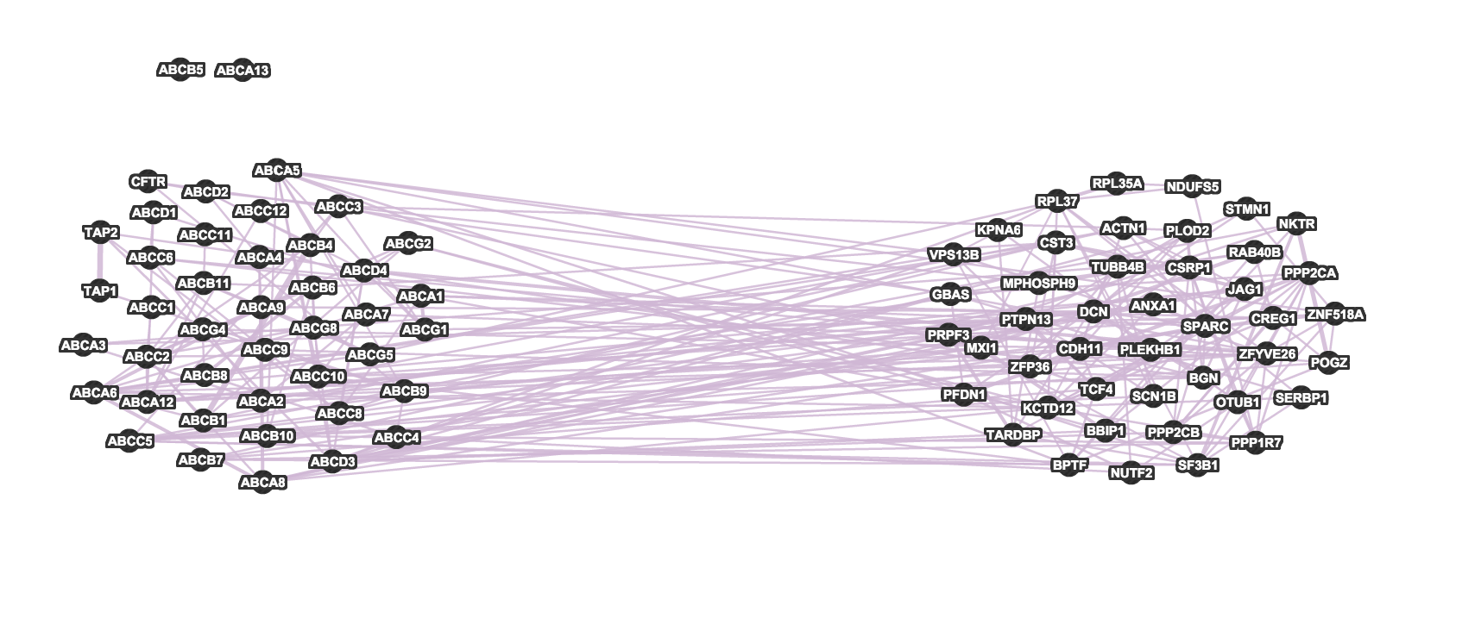
ABC Transporters (KEGG)

Slide 17
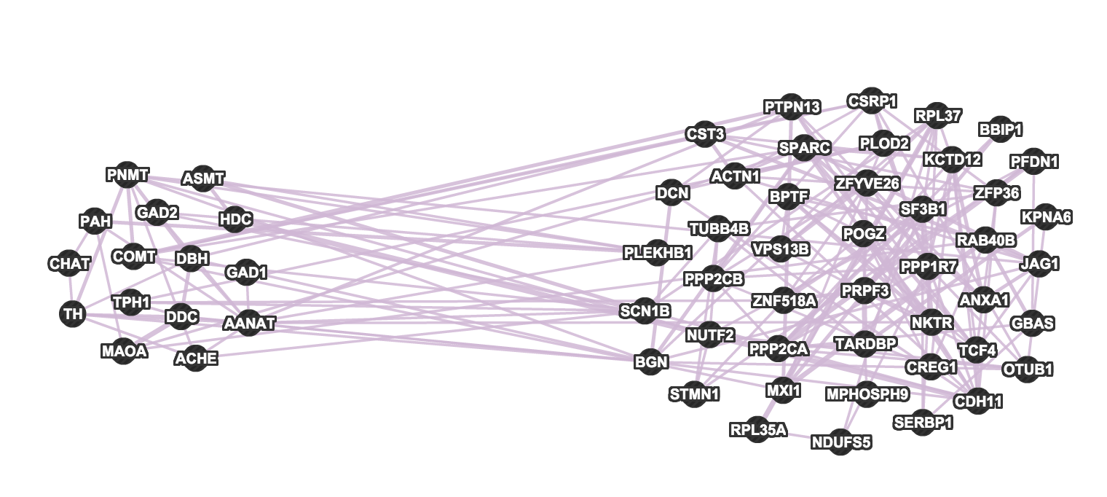
Biogenic Amine Synthesis (Wikipathways)

Slide 18
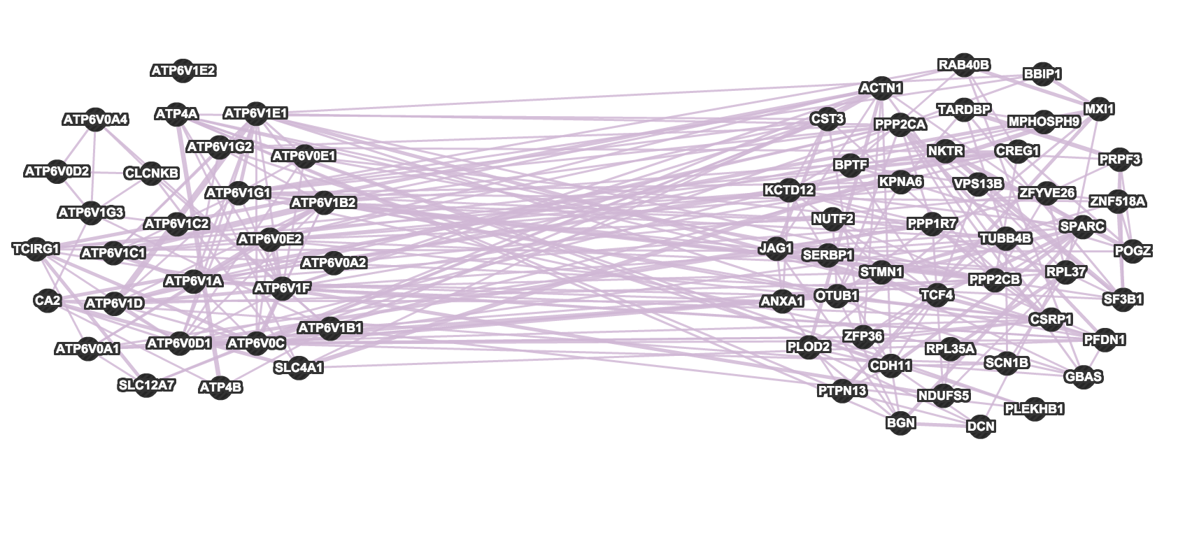
Collecting Duct Acid Secretion (KEGG)

Slide 19
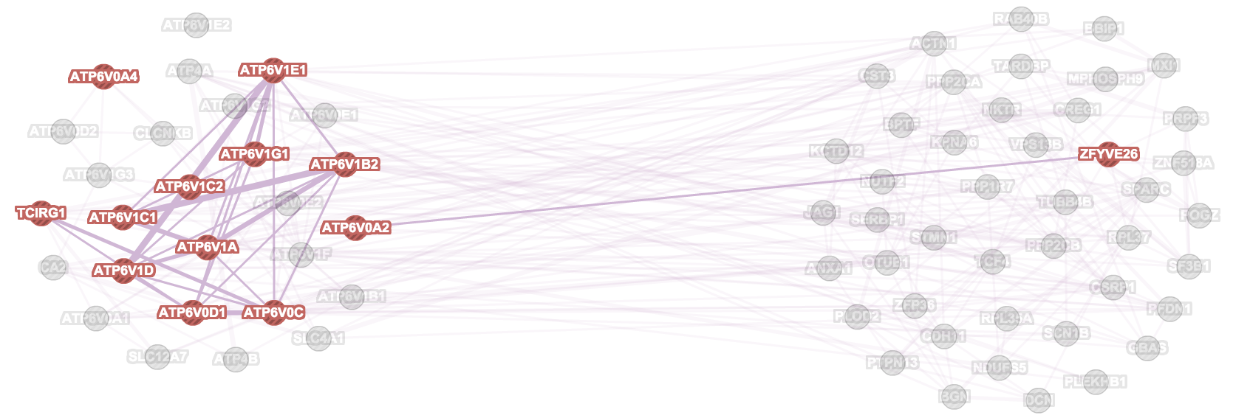
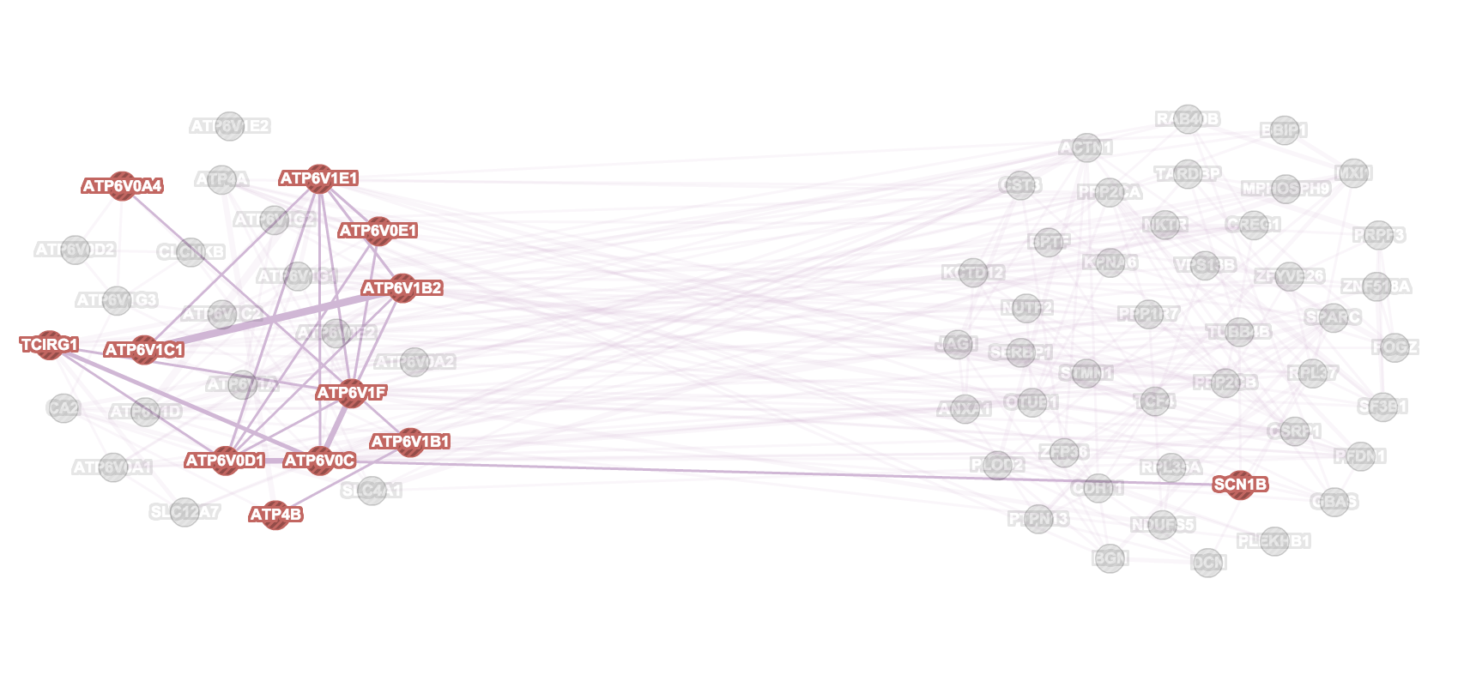
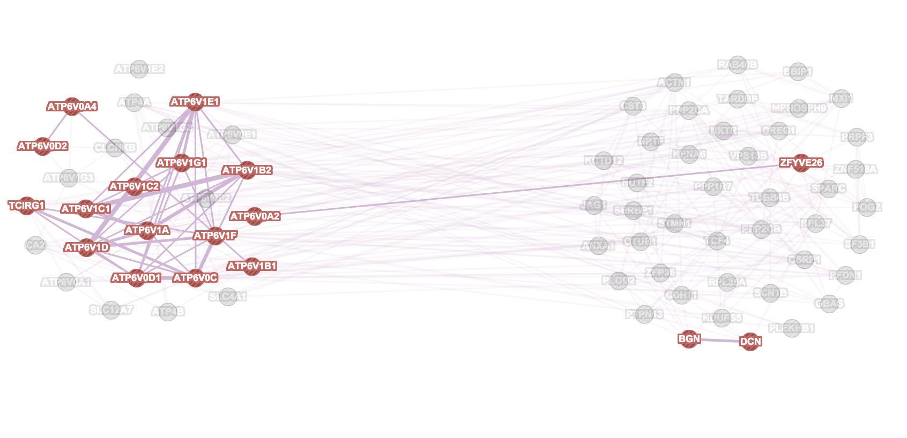
Lysosomal membrane
Monovalent inorganic ion transport
NLS-bearing protein import into nucleus
Vacuolar part
Nuclear Transport

Slide 20
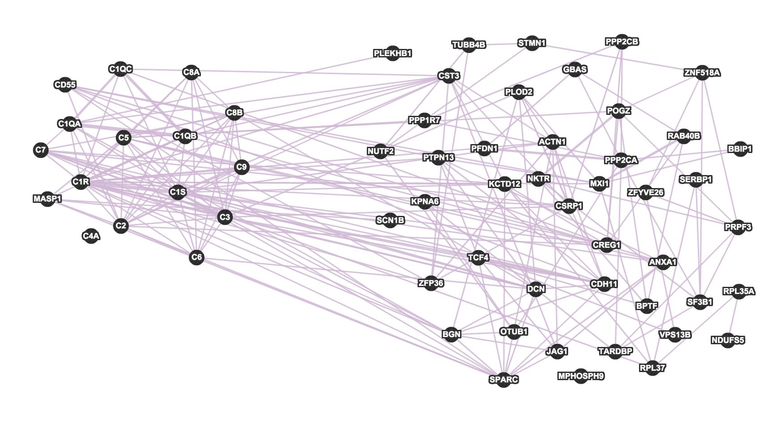
Complement Activation, Classical Pathway (Wikipathways)

Slide 21
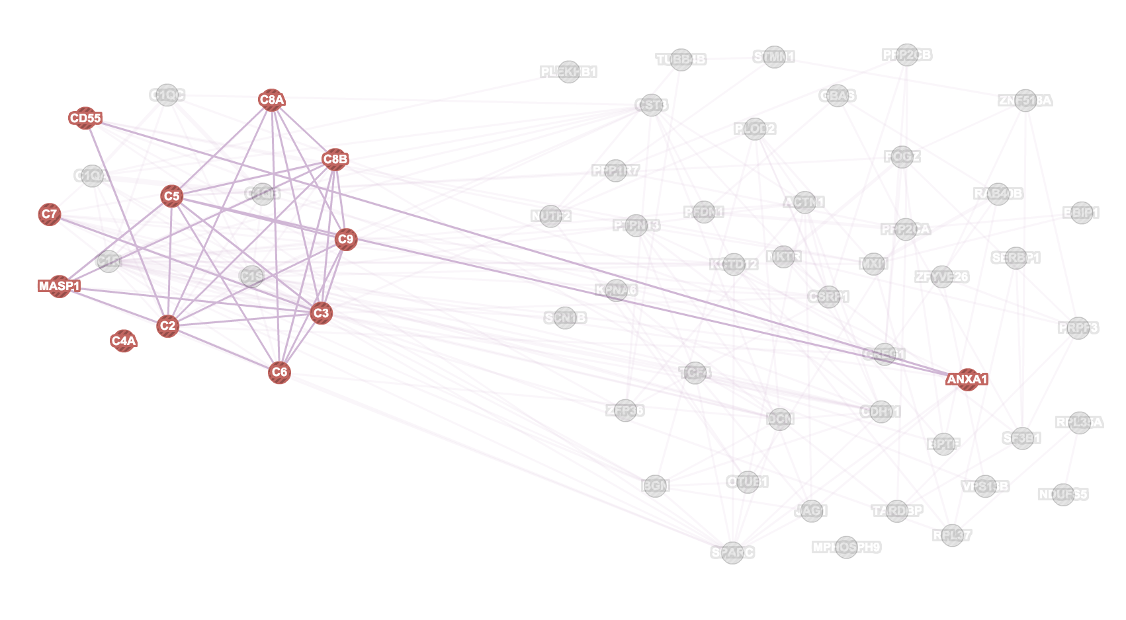
Inflammatory Response

Slide 22
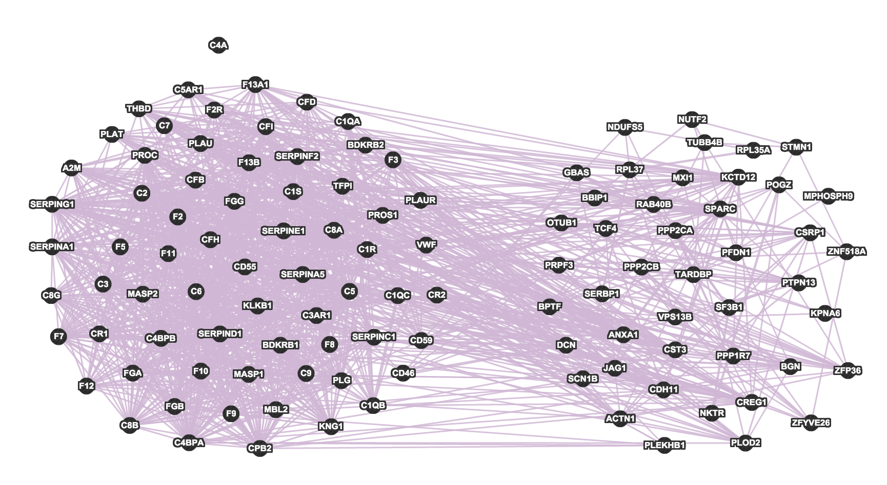
Complement and coagulation cascades (KEGG)

Slide 23
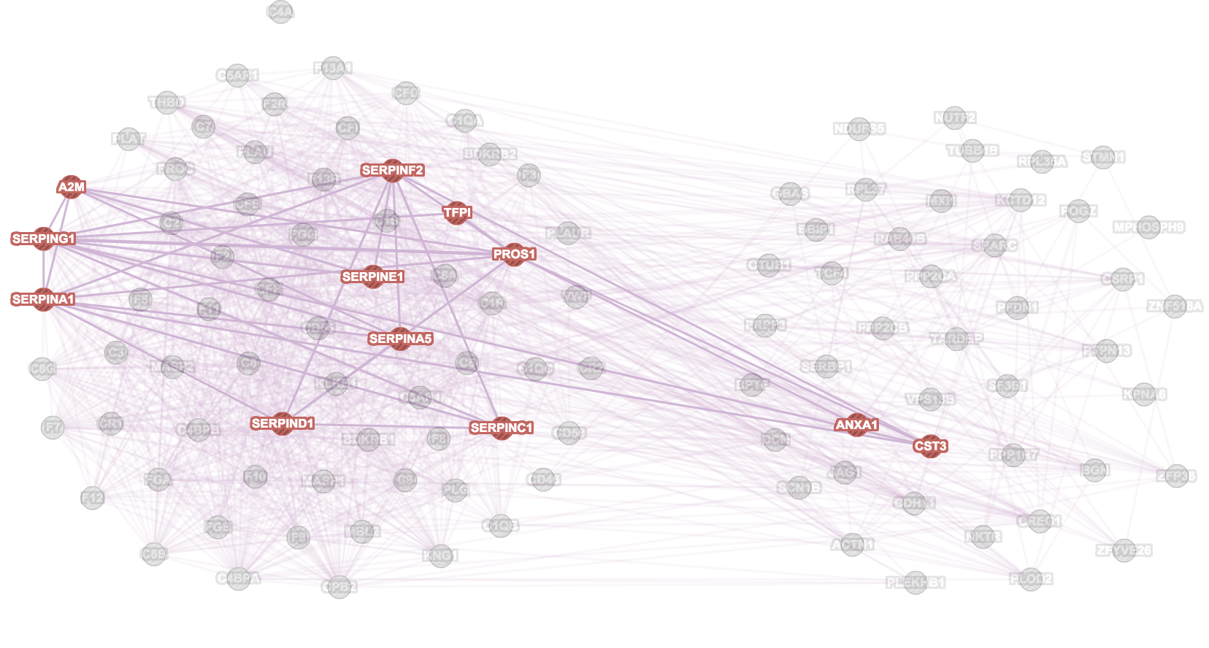
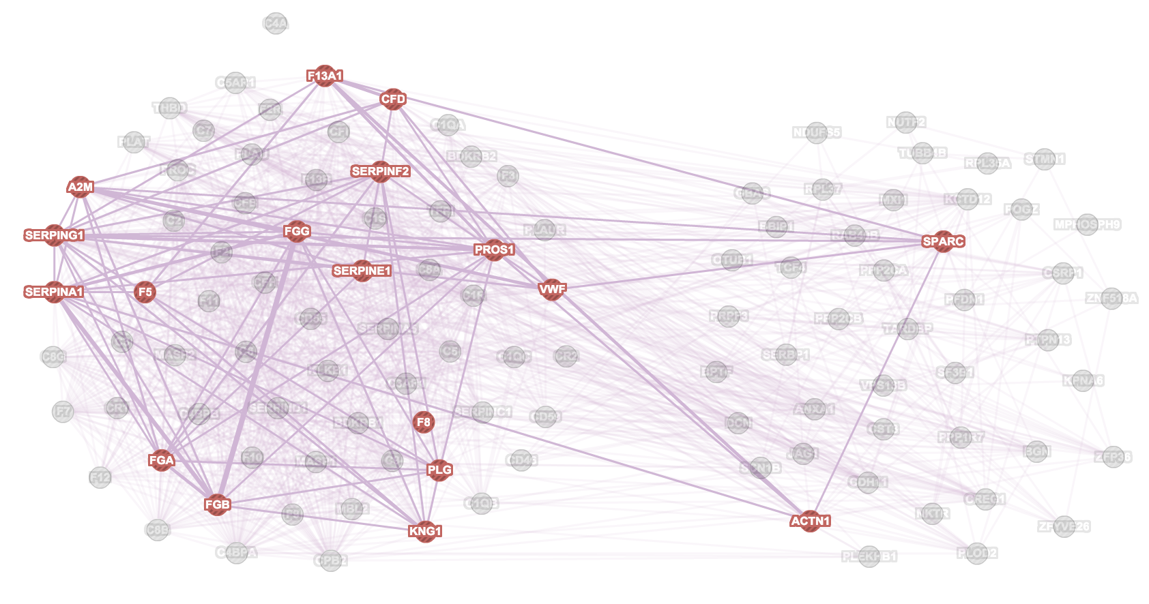
Enzyme inhibitor activity
Exocytosis

Slide 24
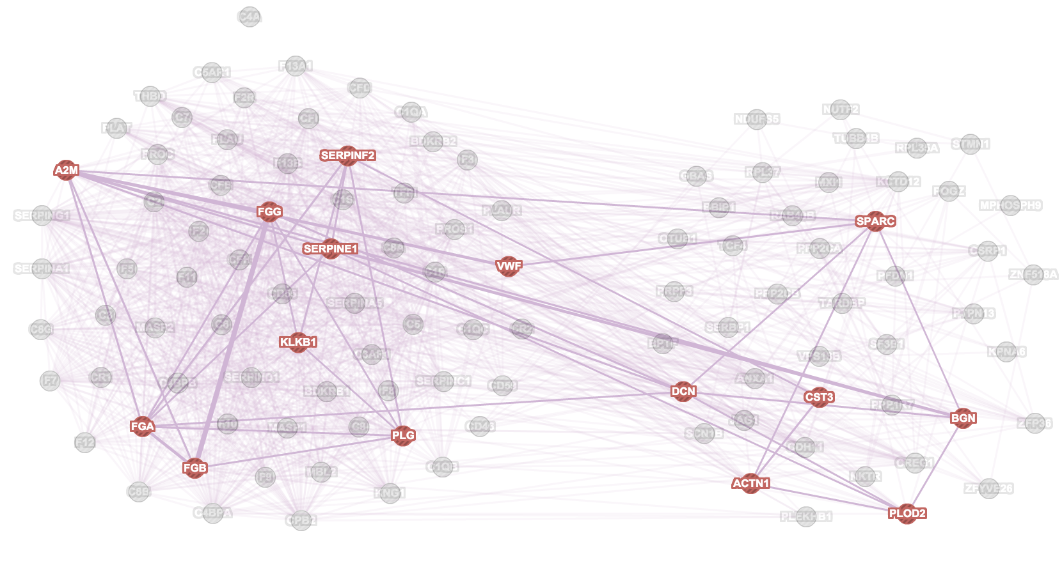
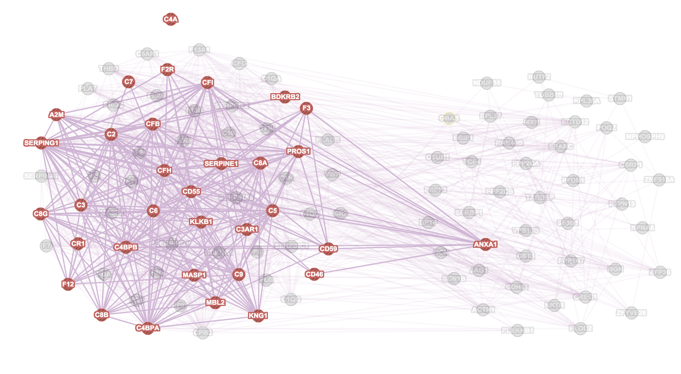
Extracellular matrix organisation
Inflammatory Response

Slide 25
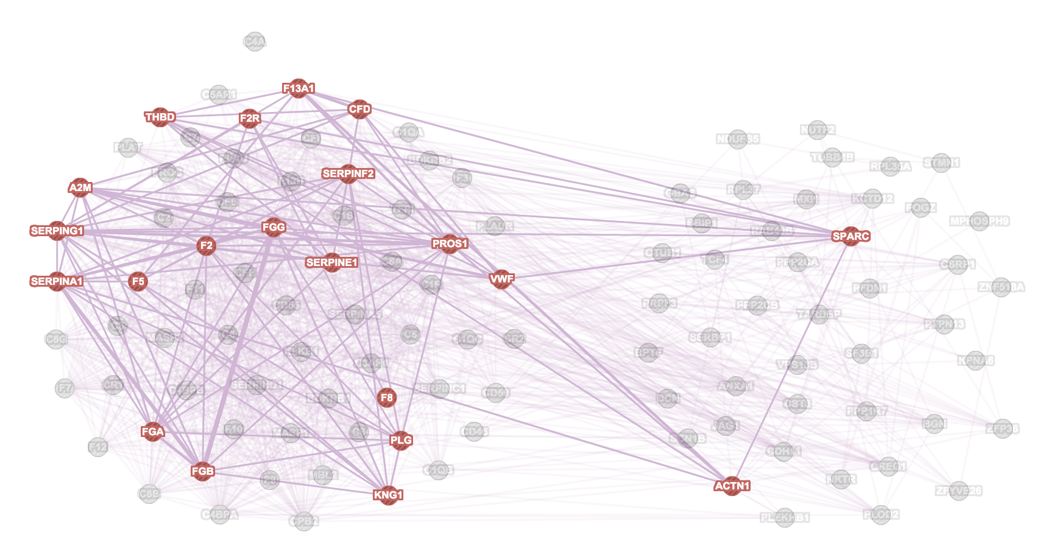
Extracellular matrix organisation
Platelet activation

Slide 26
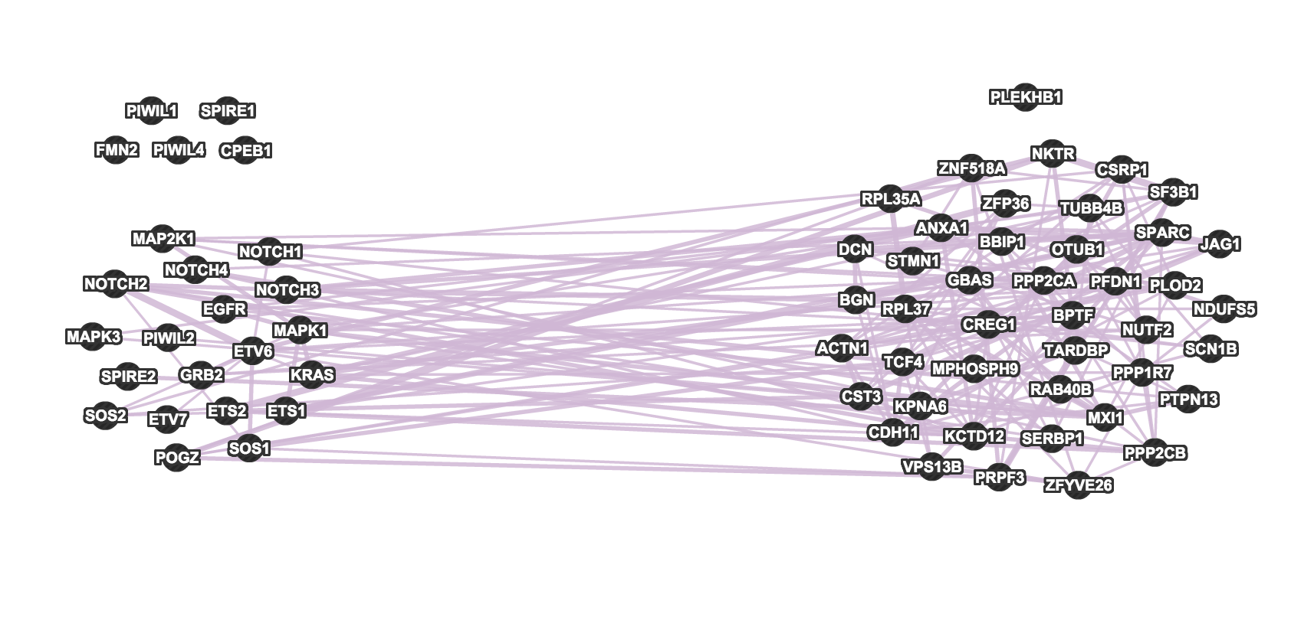
Dorso-ventral Axis Formation (KEGG)

Slide 27
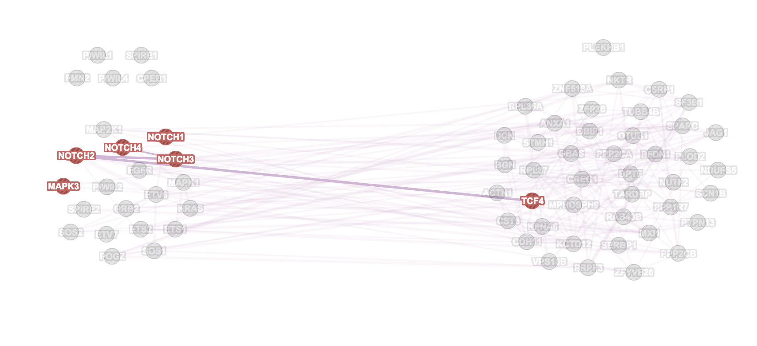
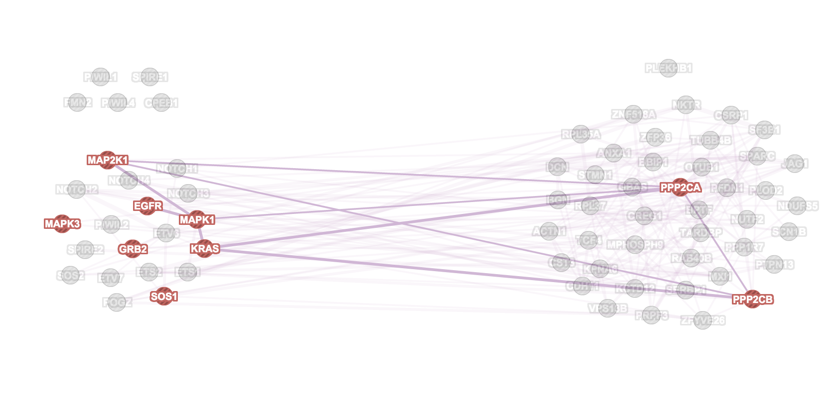
DNA templated transcription initiation
Fibroblast growth factor receptor stimulus pathway

Slide 28
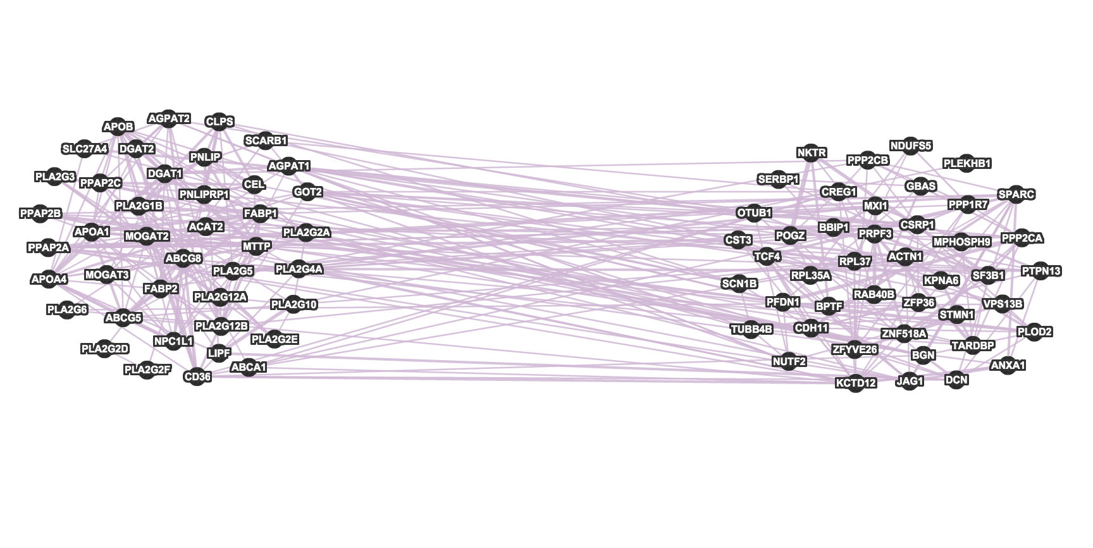
Fat Digestion and Absorption (KEGG)

Slide 29
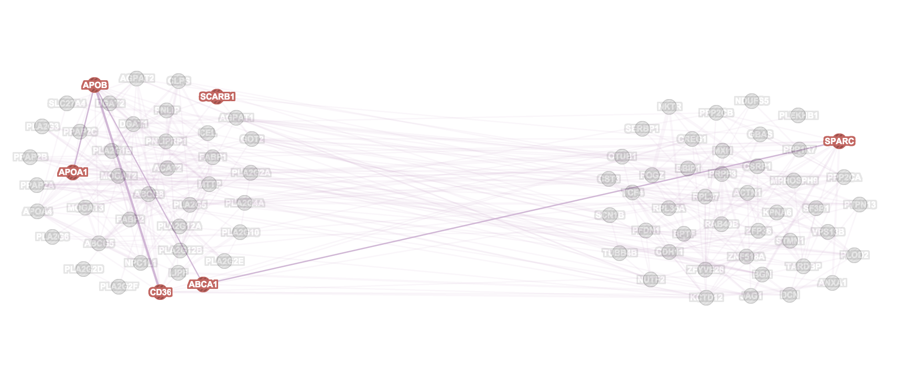
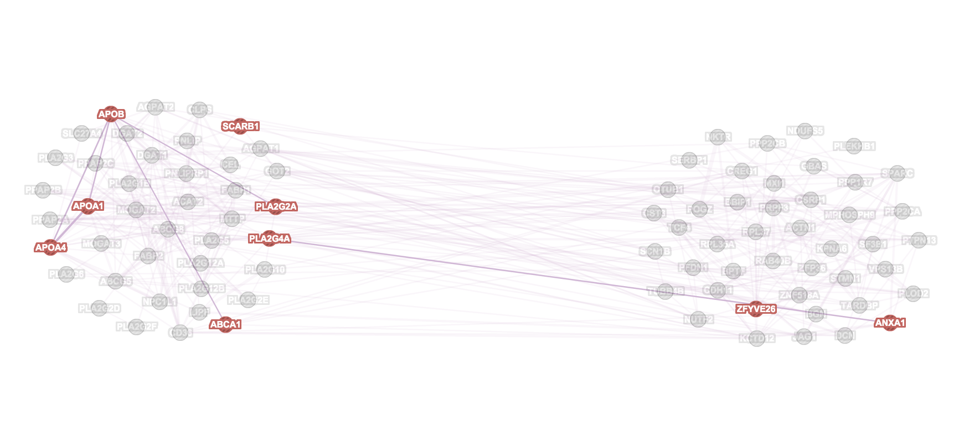
Endocytic vesicle
Phospholipid binding

Slide 30
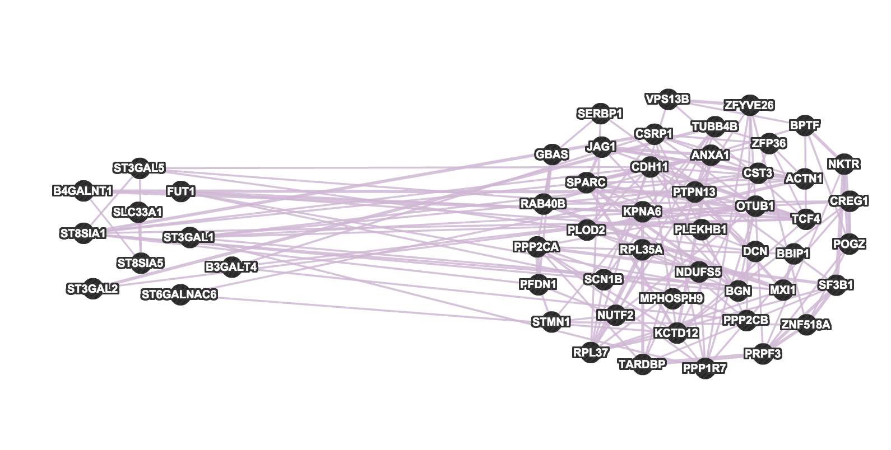
Ganglio Sphingolipid Metabolism (Wikipathways)

Slide 31
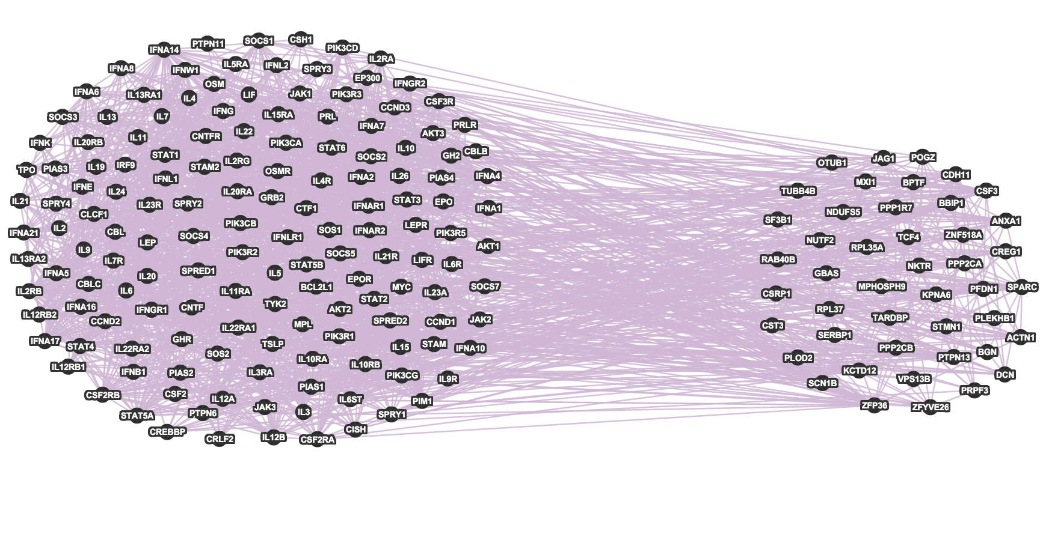
JAK-STAT Signalling Pathway (KEGG)

Slide 32
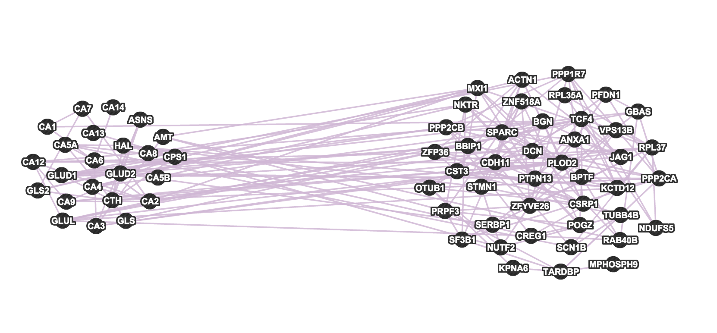
Nitrogen Metabolism (KEGG)

Slide 33
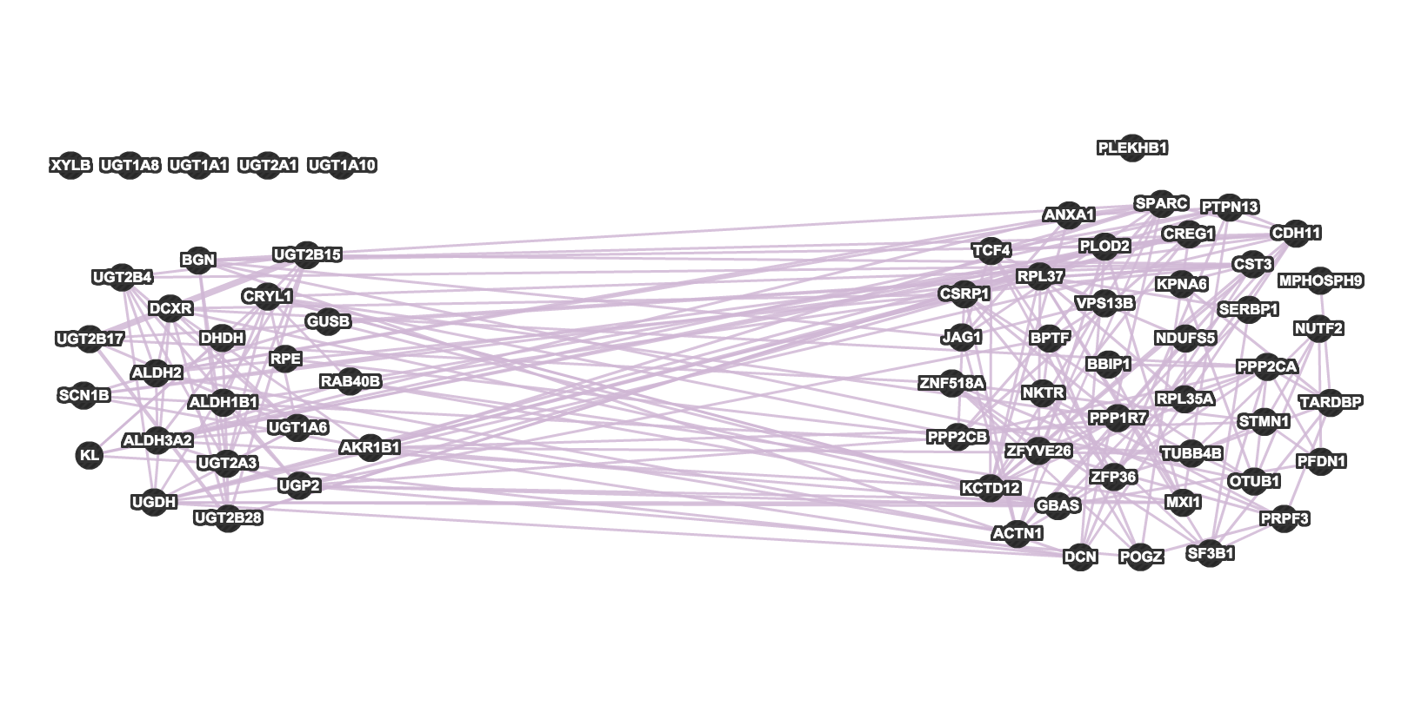
Pentose and Glucuronate Interconversions (KEGG)

Slide 34
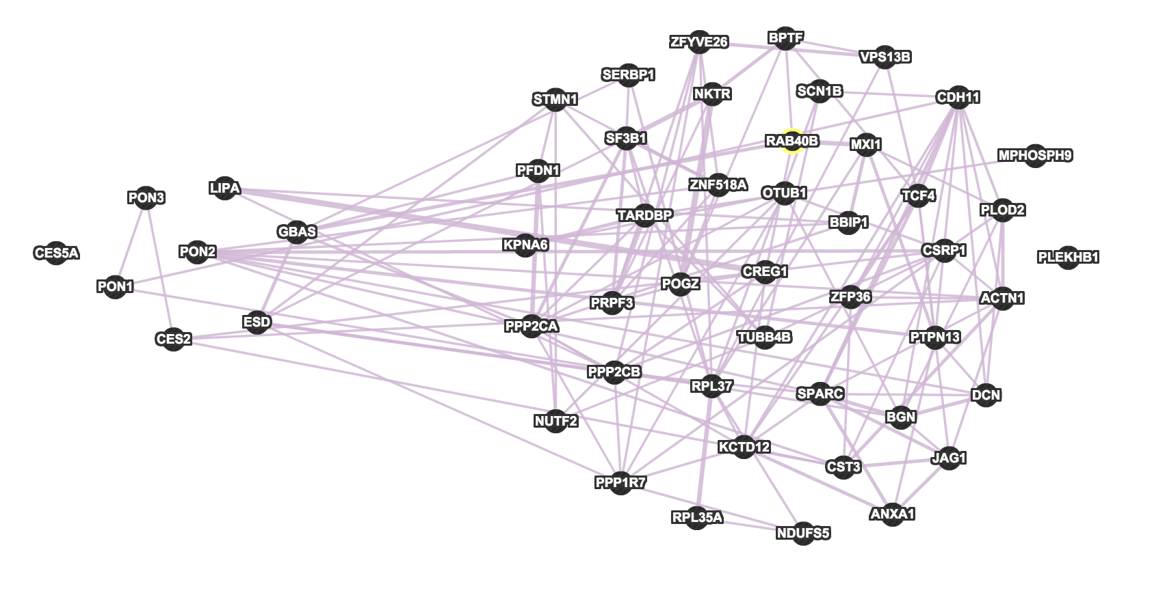
Phase I, non-P450 (Wikipathways)

Slide 35
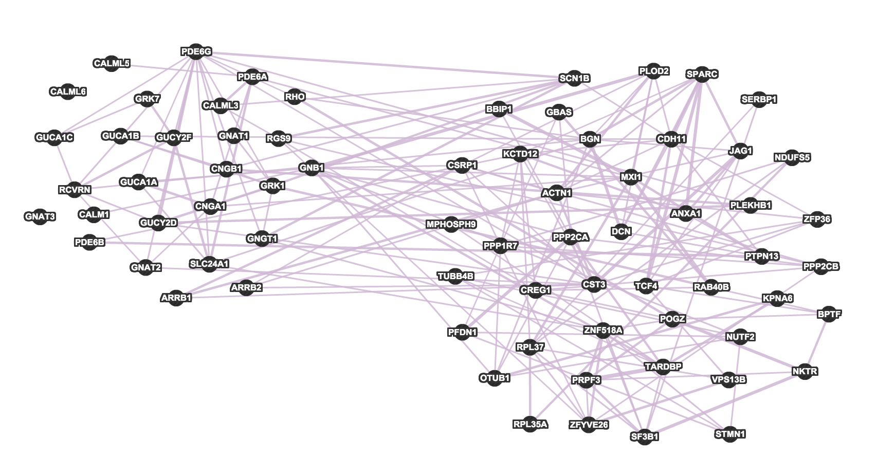
Phototransduction (KEGG)

Slide 36
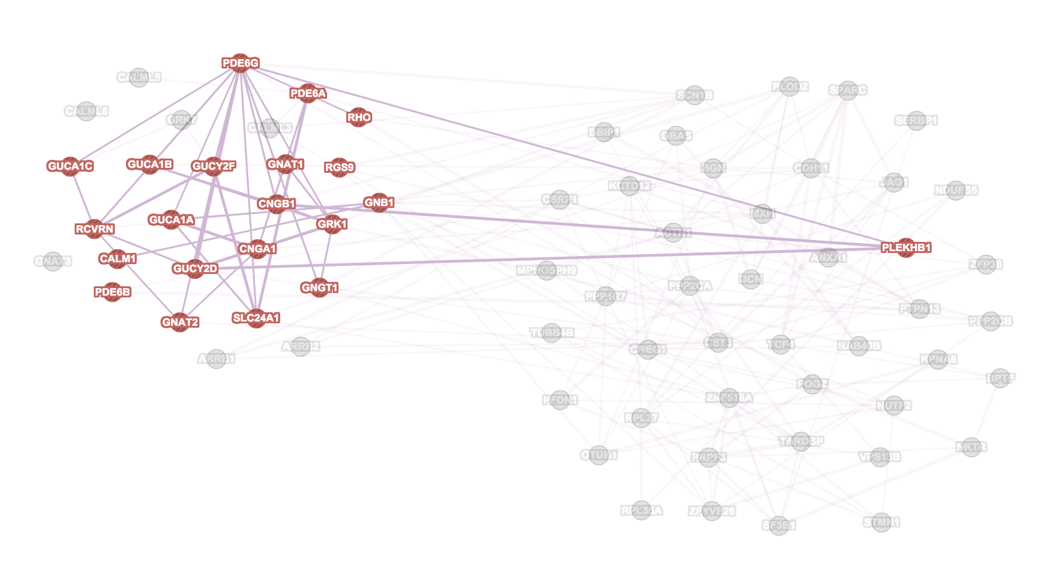
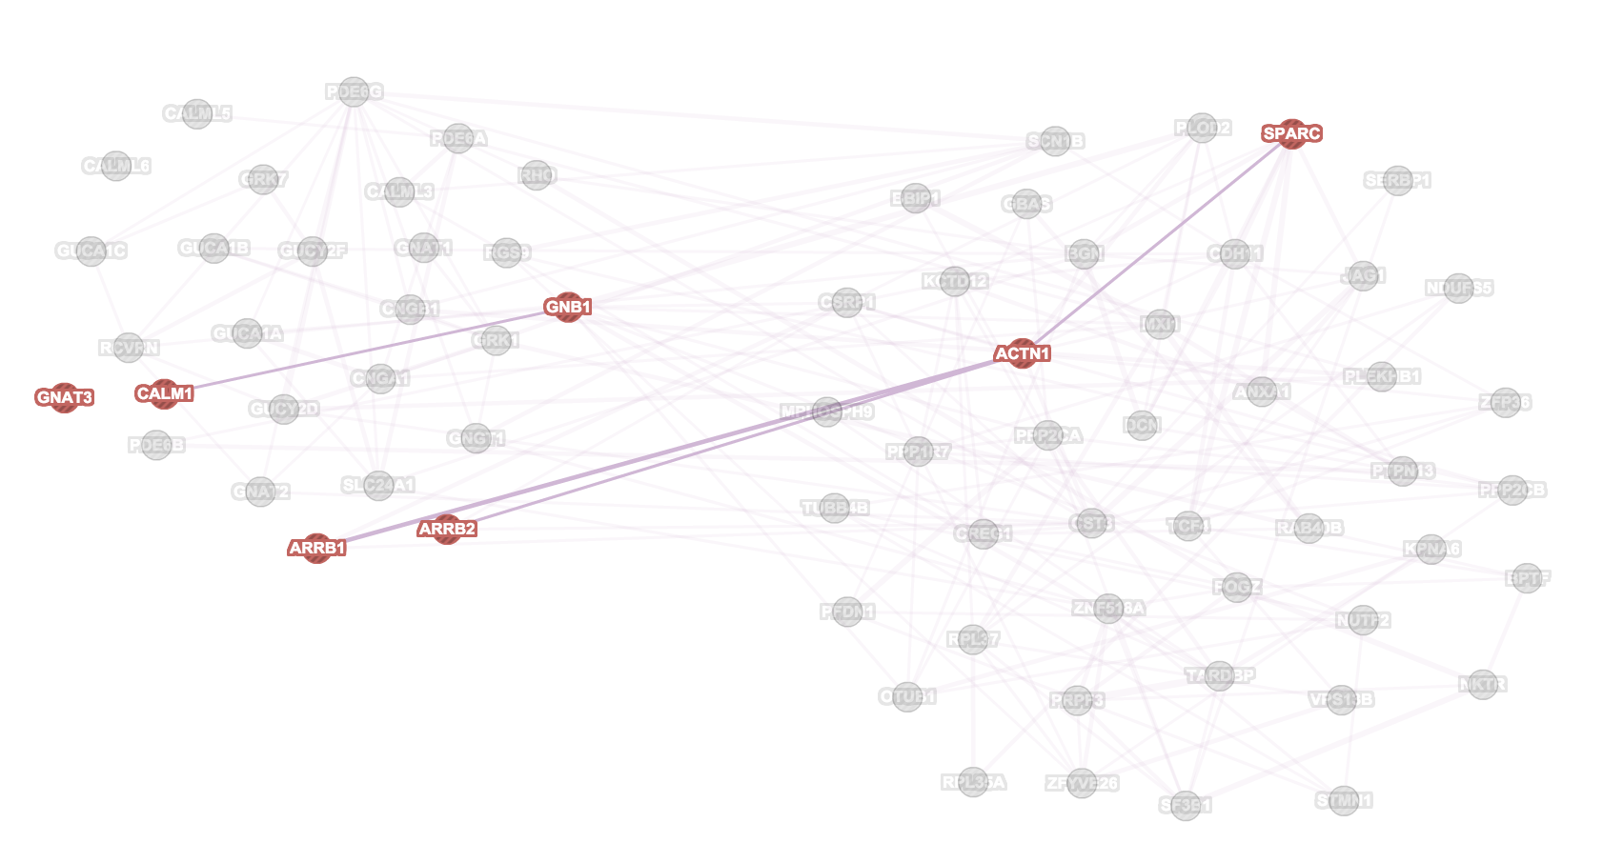
Phototransduction
Platelet activation

Slide 37
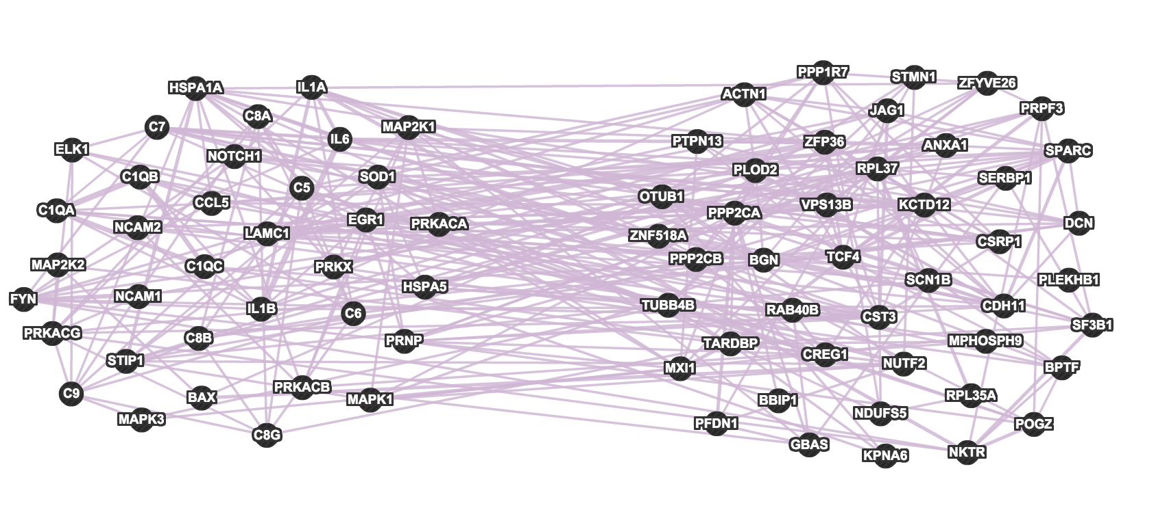
Prion Diseases (KEGG)

Slide 38
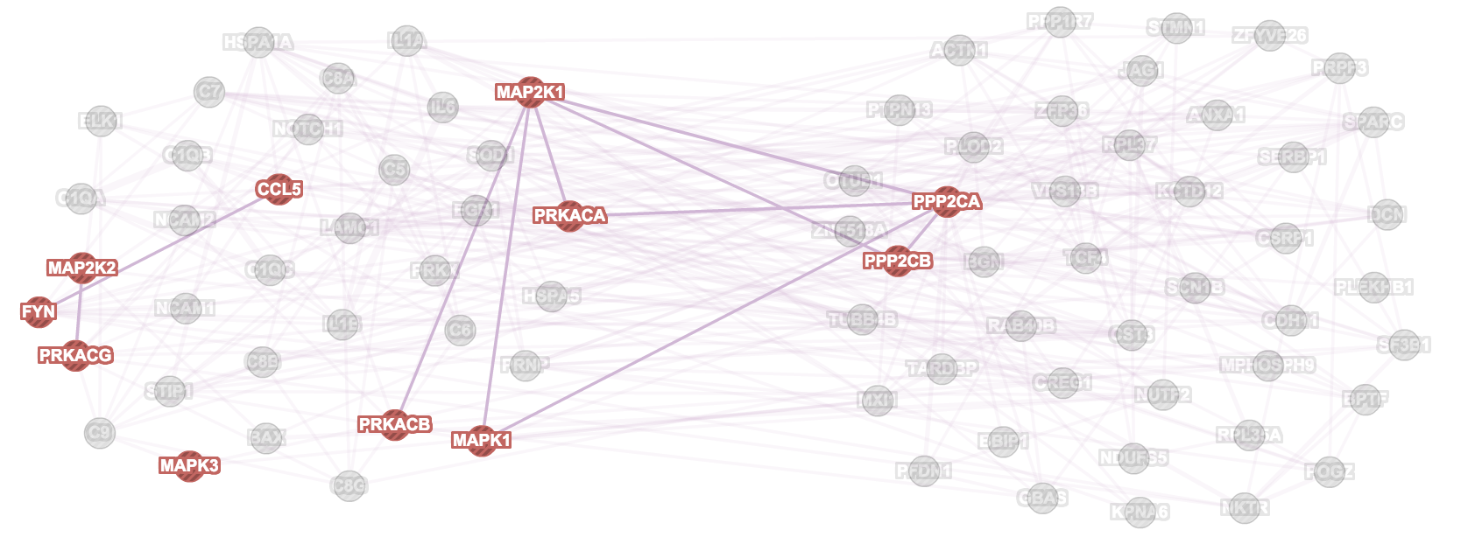

Cellular response to fibroblast growth factor stimulus
Inflammatory response

Slide 39


Platelet activation
T cell activation

Slide 40

Signalling by Insulin Receptor (Reactome)

Slide 41


Nucleocytoplasmic transport
Platelet activation

Slide 42


Posttranscriptional regulation of gene expression
fibroblast growth factor receptor signalling pathway

Slide 43

Starch and Sucrose Metabolism (KEGG)

Slide 44

Urea Cycle and Metabolism of Amino Groups (Wikipathways)

